Slide 1
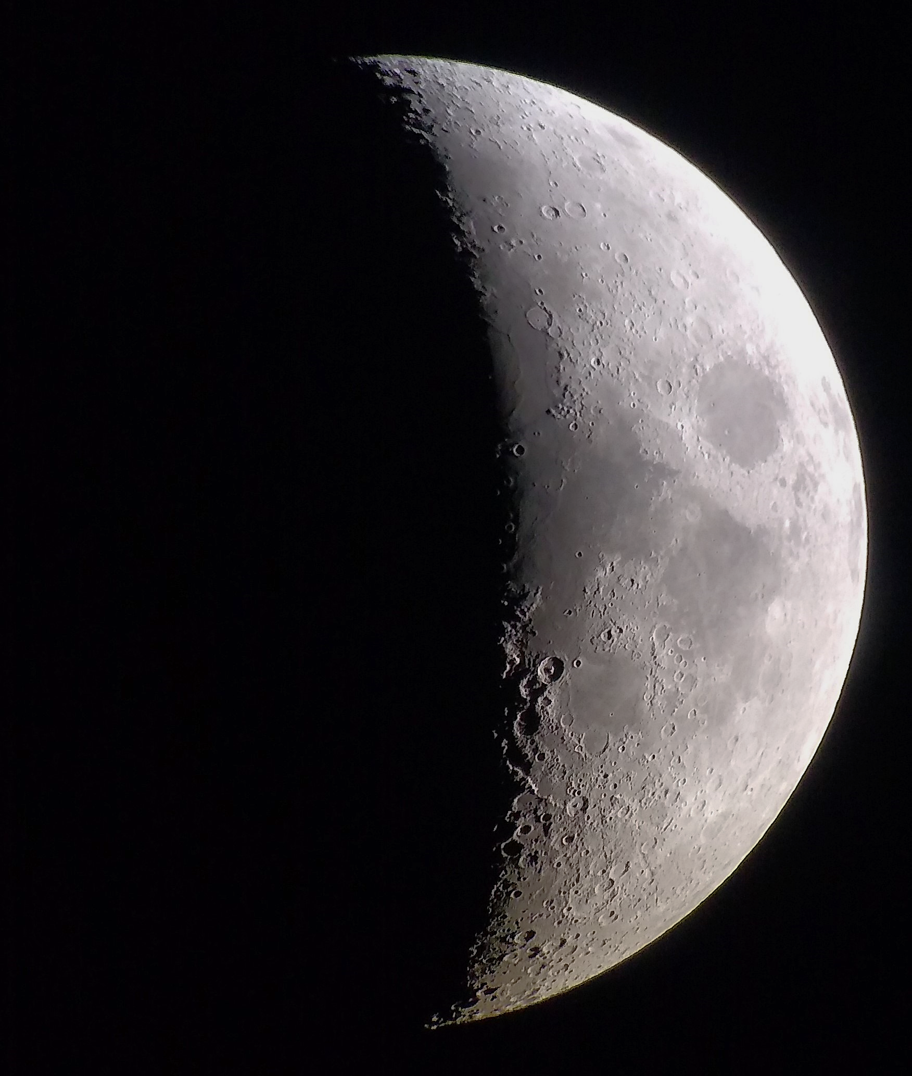
Meteoroid Ejecta of Lunar Secondaries Engineering Model
Anthony M. DeStefano
NASA/MSFC/EV44 Natural Environments
Applied Space Environments Conference 2021

Slide 2
Outline
A Typical Meteoroid Ejecta Model Algorithm
Current Meteoroid Ejecta Environment – NASA SP-8013
Updated Model – Meteoroid Ejecta of Lunar Secondaries Engineering Model (MELSEM) – under NESC review
Primary Environments
Asset Geometry and Location
Scaling Laws
Secondary Environment at Asset
Risk Assessment – Probability of No Penetration

Slide 3
Typical Meteoroid Ejecta Model Algorithm
What are the primary impactors?
Cumulative flux as a function of impactor mass
Impactor density
Possibly angular and location-dependent information
How to convert primary mass flux into ejected mass flux?
Scaling laws – extrapolations from laboratory experiments and/or theory
How is the ejected mass flux distributed – starting from primary impact location?
Solid angle
Particle size and density
Speed
For a given observer, what is the total ejected mass flux, accounting for impacts over the entire surface of the Moon?
Solid angle
Particle size and density
Speed

Slide 4
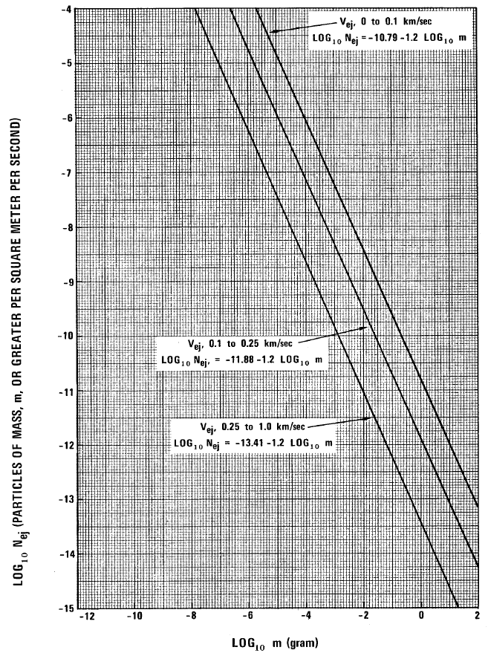
NASA SP-8013 – Lunar Ejecta Environment
The Cross-Program Design Specification for Natural Environments (DSNE), Section 3.4.8.2 points to NASA SP-8013, Section 3.2 for the Meteoroid Ejecta Environment
Power-law expressions are given for various ejecta speed ranges of the cumulative flux as a function of ejecta particle mass
A single particle density is assumed at 2.5 g/cm³

Slide 5
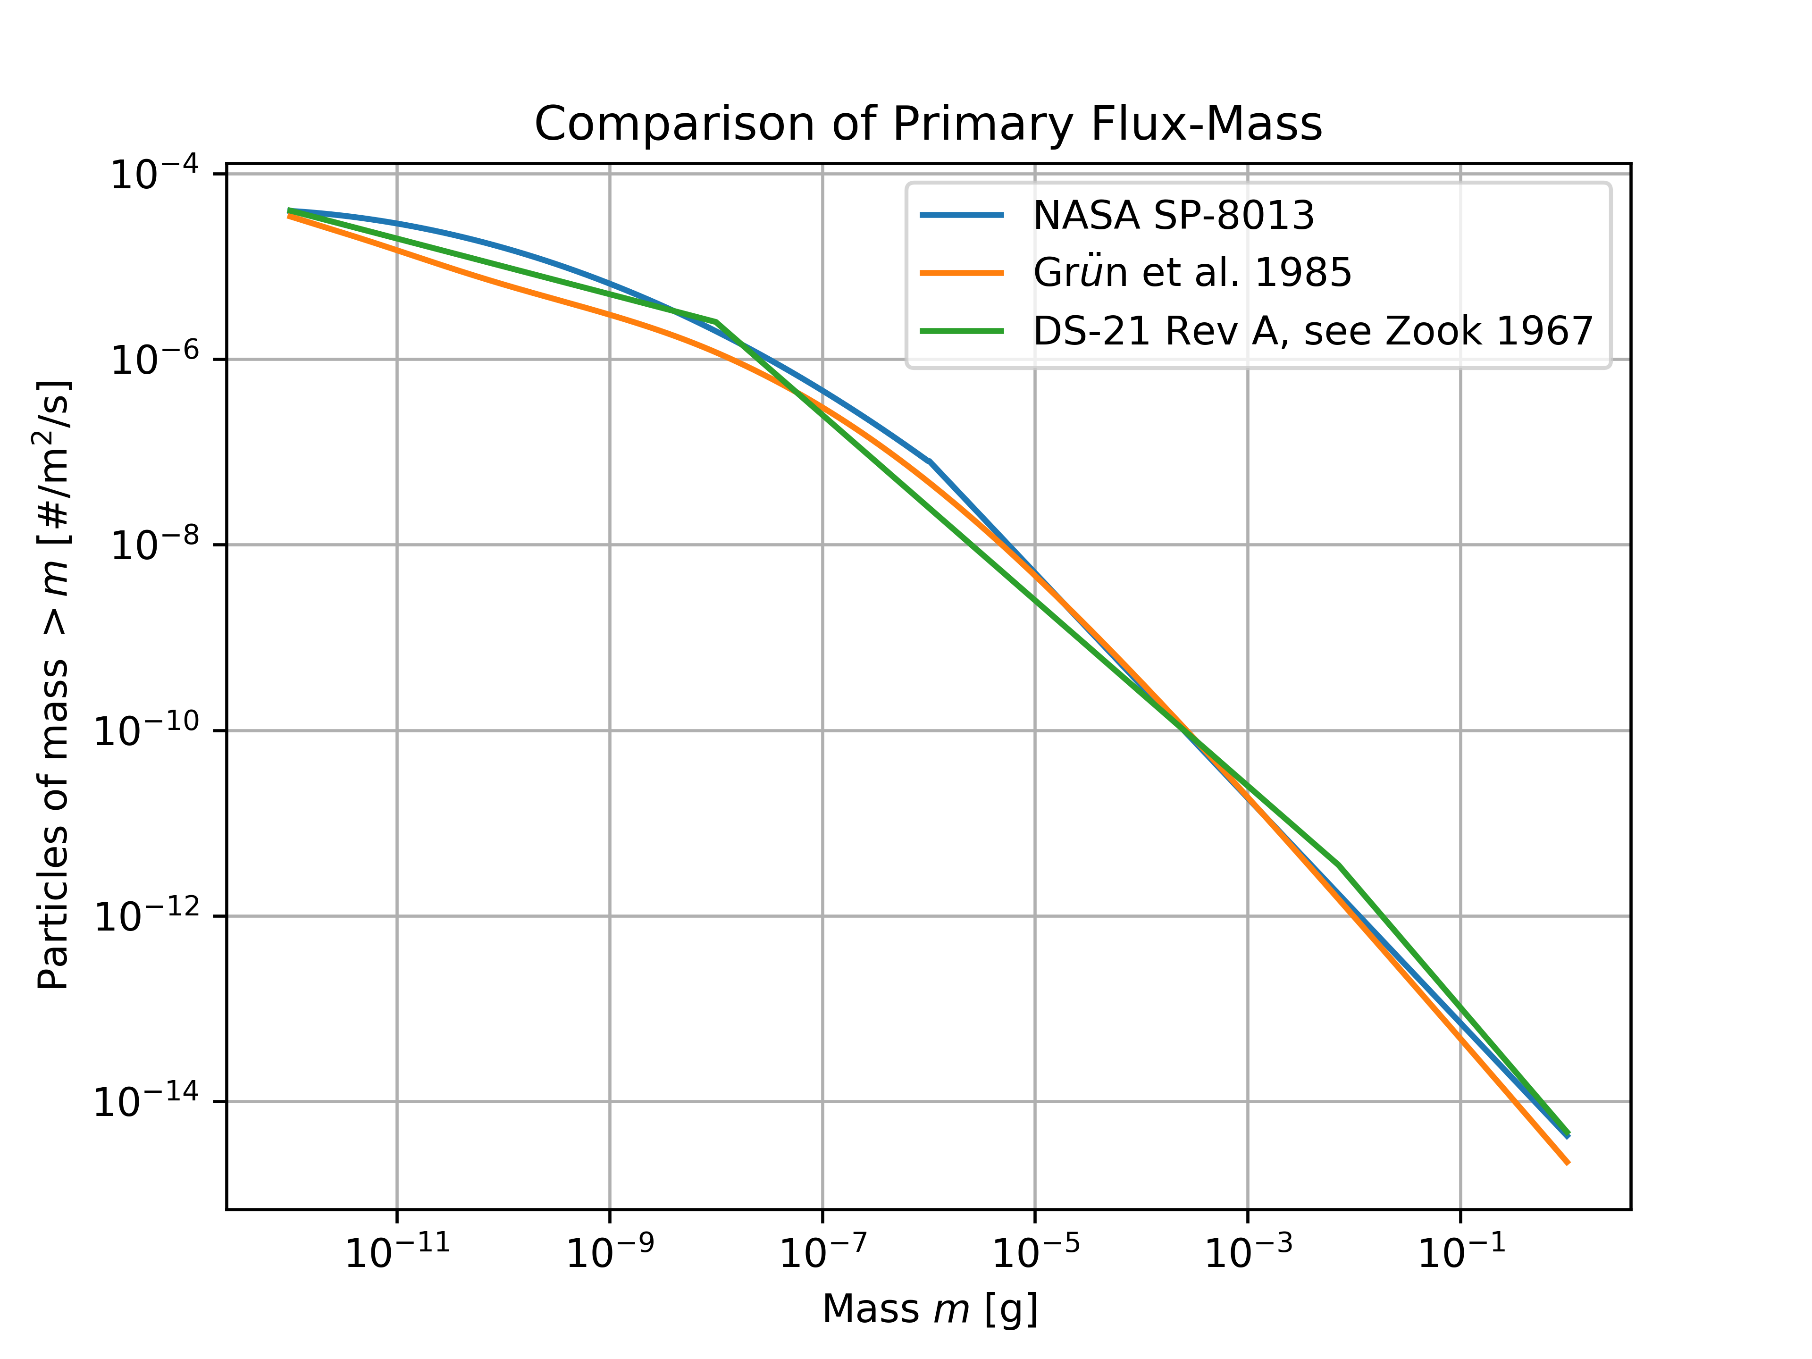
NASA SP-8013 – Lunar Ejecta Environment
NASA SP-8013 is consistent with Grun et al. 1985
Grun et al. 1985 is used to scale the Meteoroid Engineering Model (MEM) for primary sizes of 1 ug to 10 g
Scaling laws implied in NASA SP-8013 are from Zook 1967

Slide 6
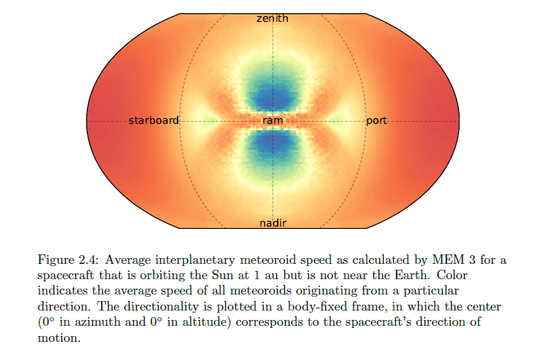
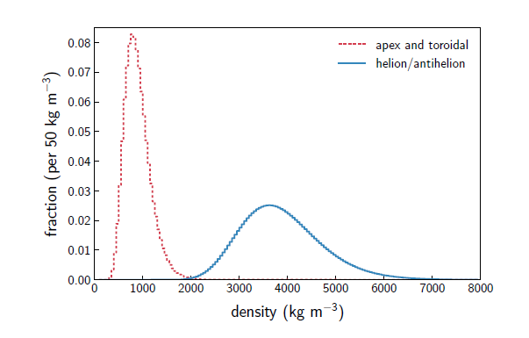
Sporadic meteoroid flux (low and high density populations in MEM)
Apex & toroidal
Helion/antihelion
Log-normal distributions
Moorhead 2019

Slide 7
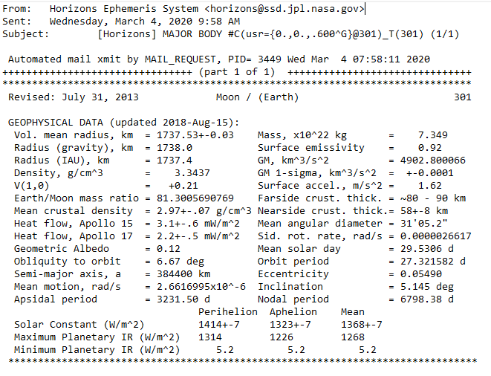
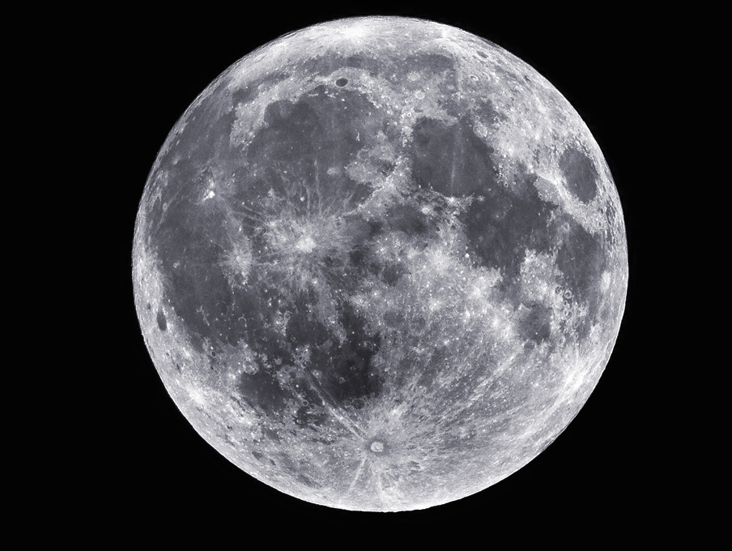
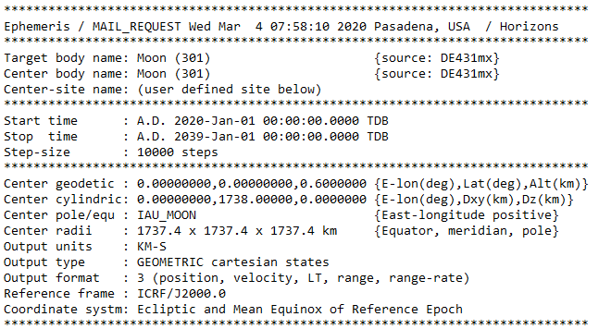
Lunar Surface Ephemeris for MEM – JPL Horizons
A total of 148 ephemeris files generated for a fixed location on the Moon
19-year (Metonic cycle) time period of trajectory
5-degree latitude intervals from south pole to north pole
90-degree longitude intervals
Timestep ~ 16 hours 40 minutes (10,000 total)

Slide 8
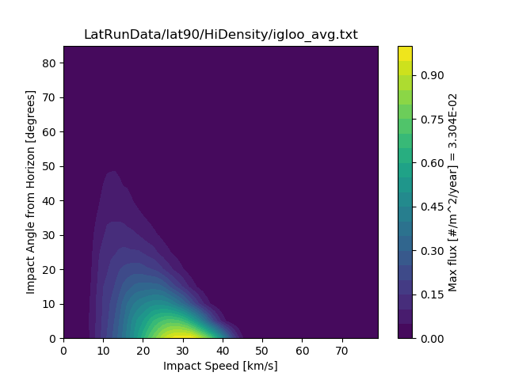
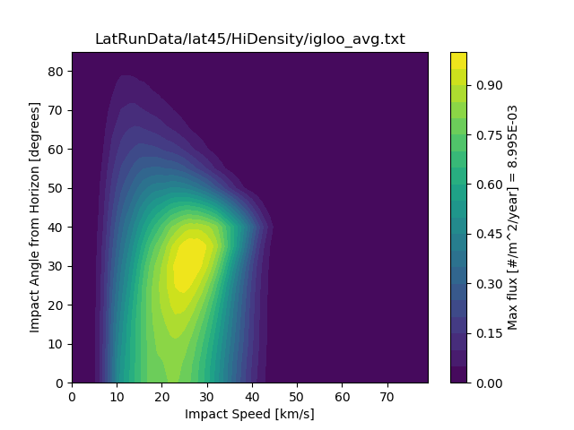
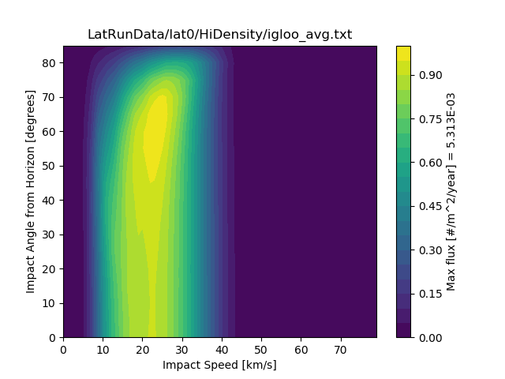
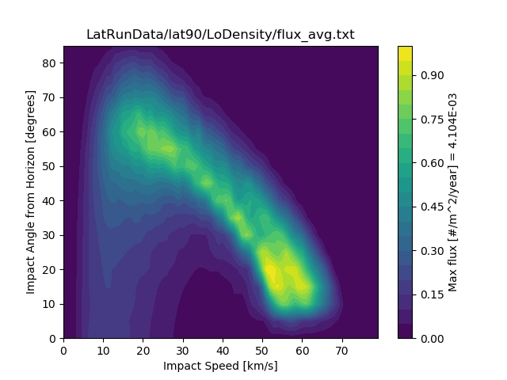
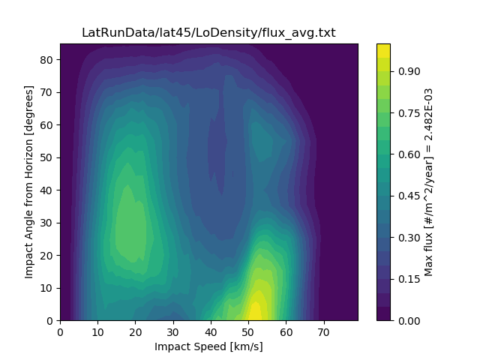
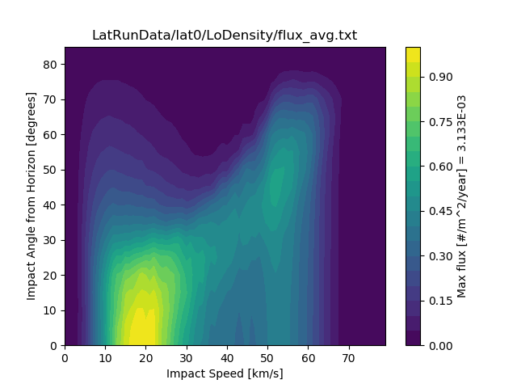
Sporadic meteoroid flux (angle/speed) and latitudinal dependence on the lunar surface

Slide 9
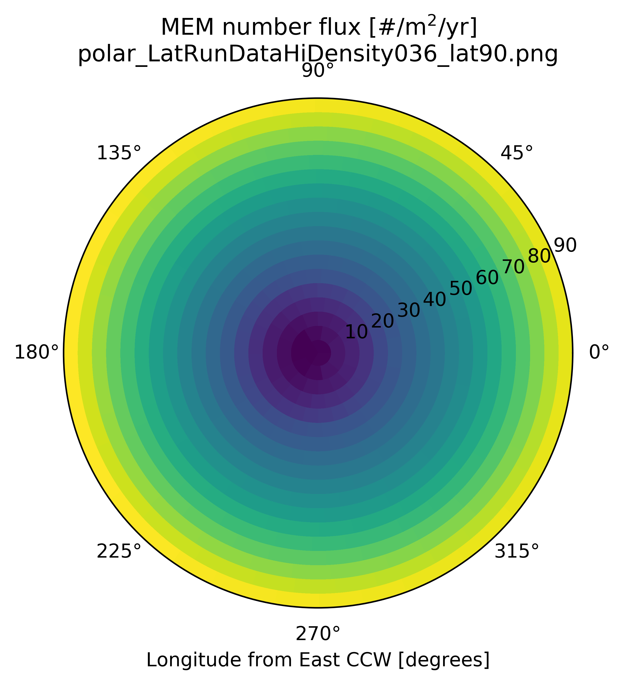
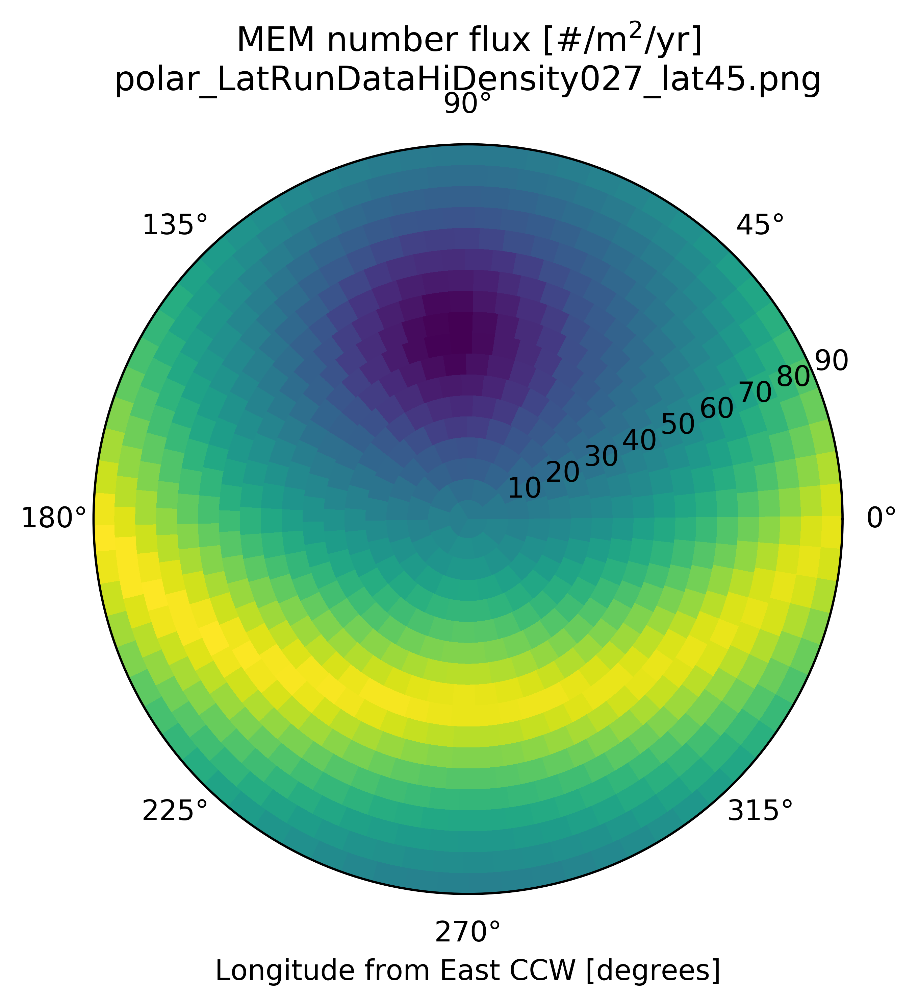
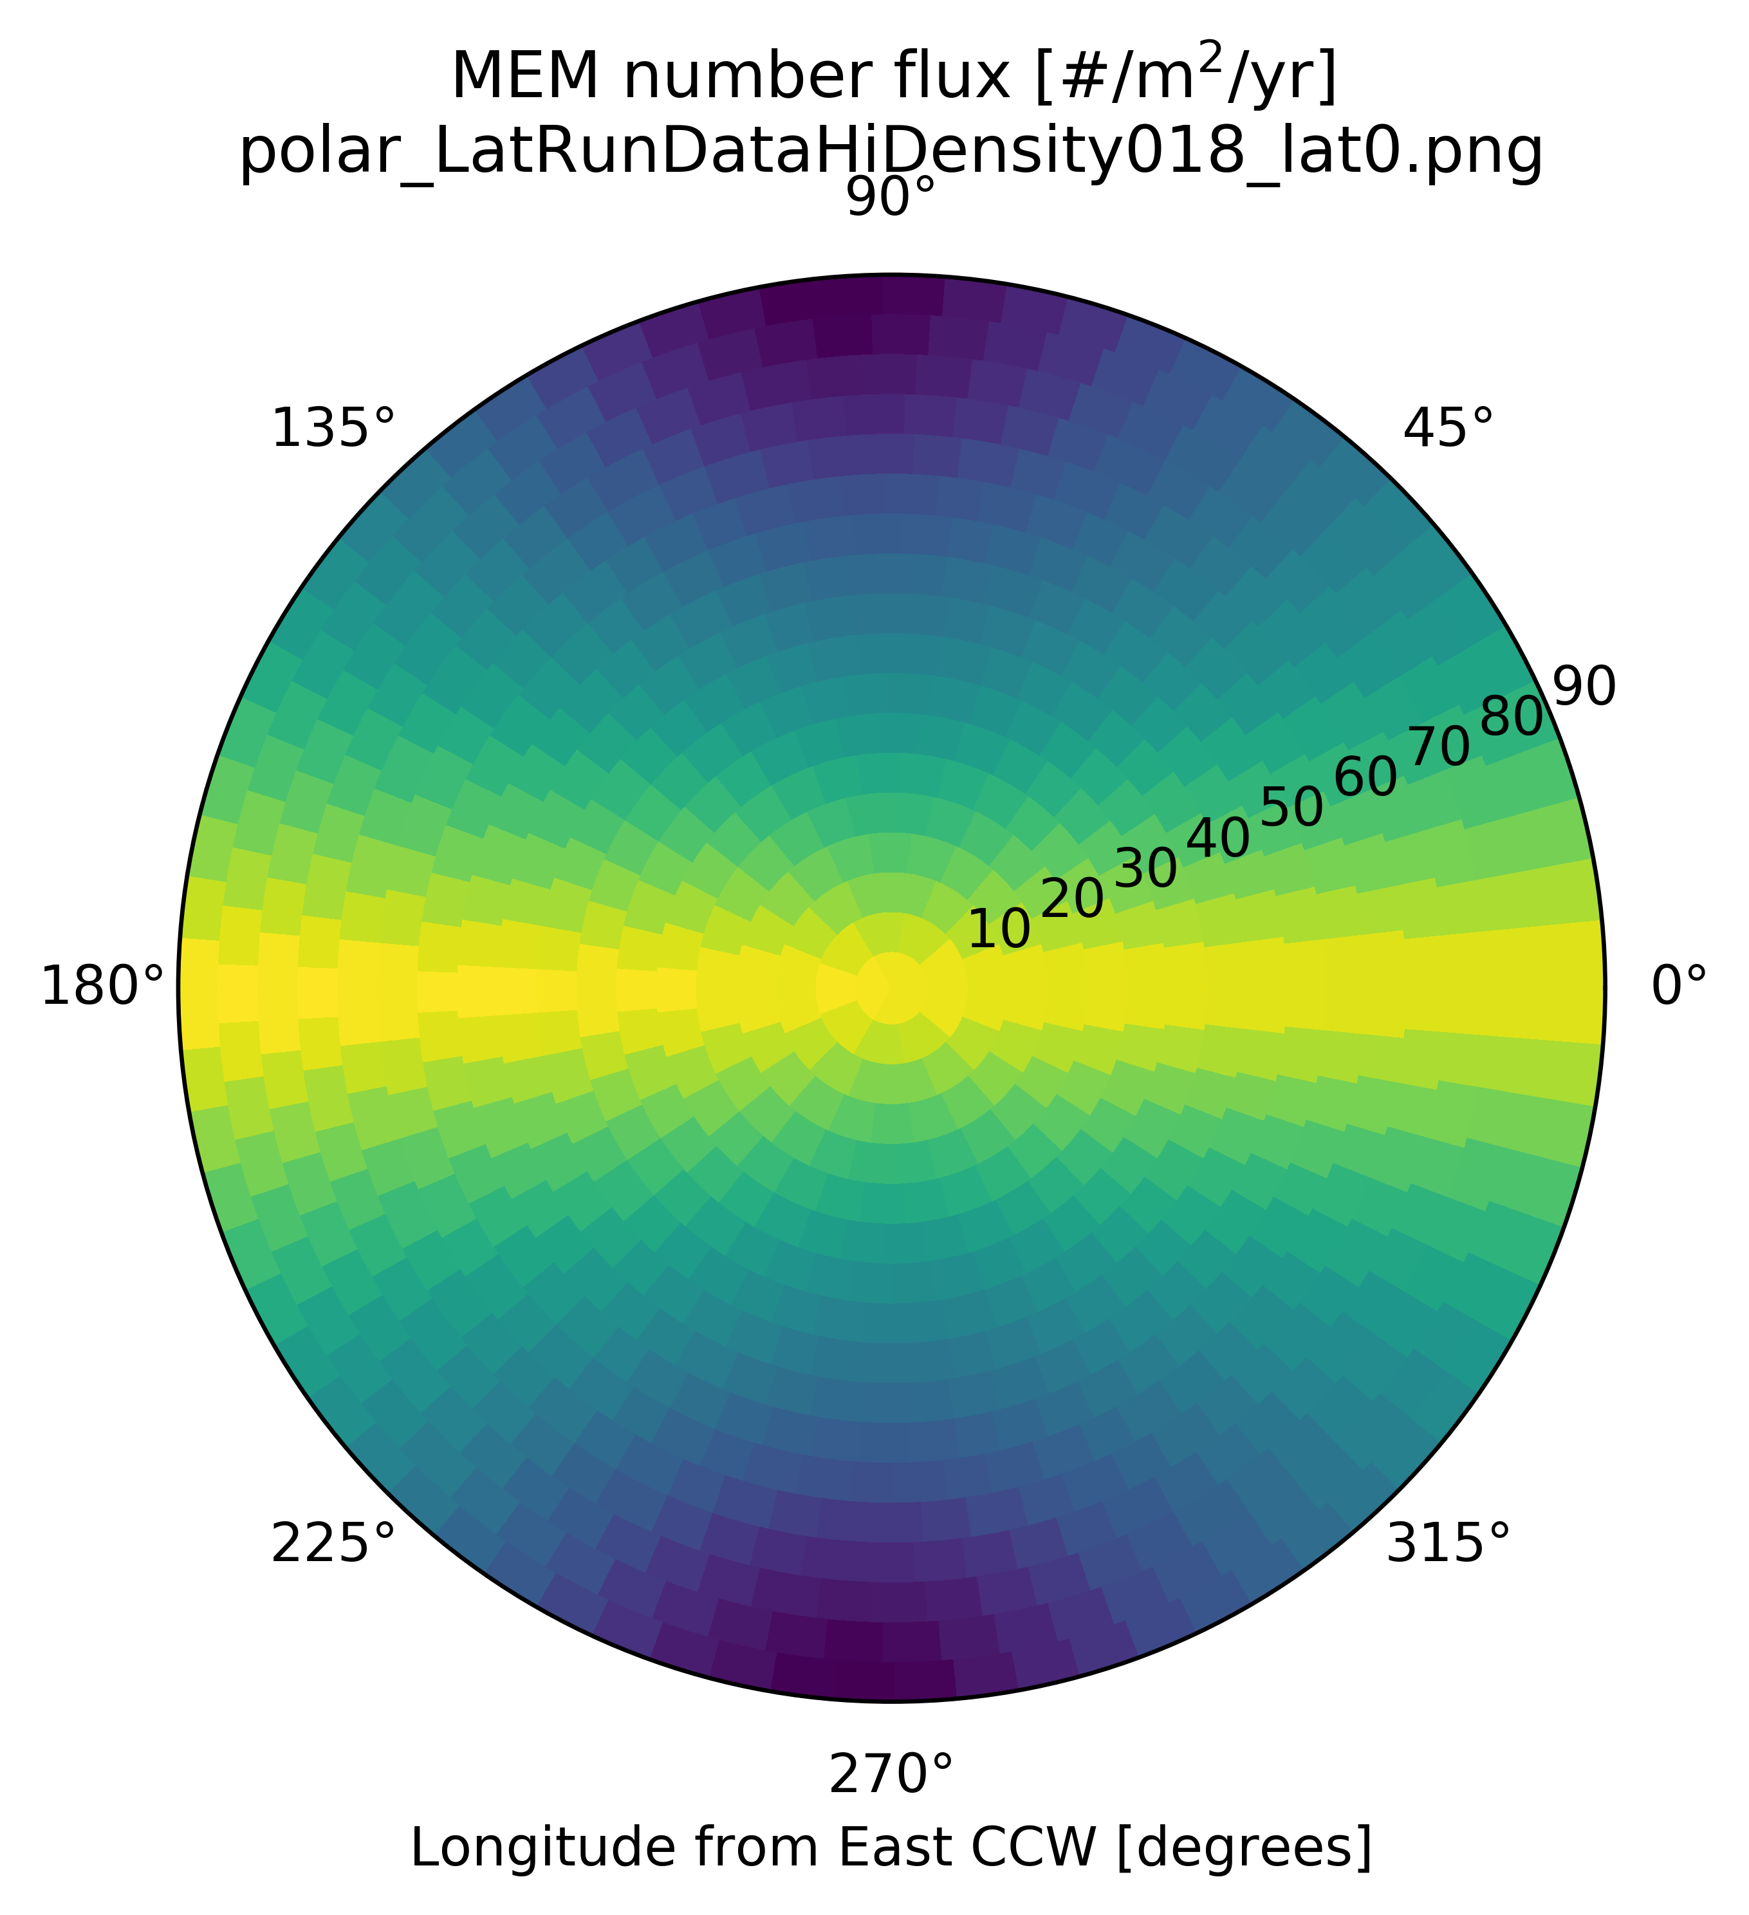
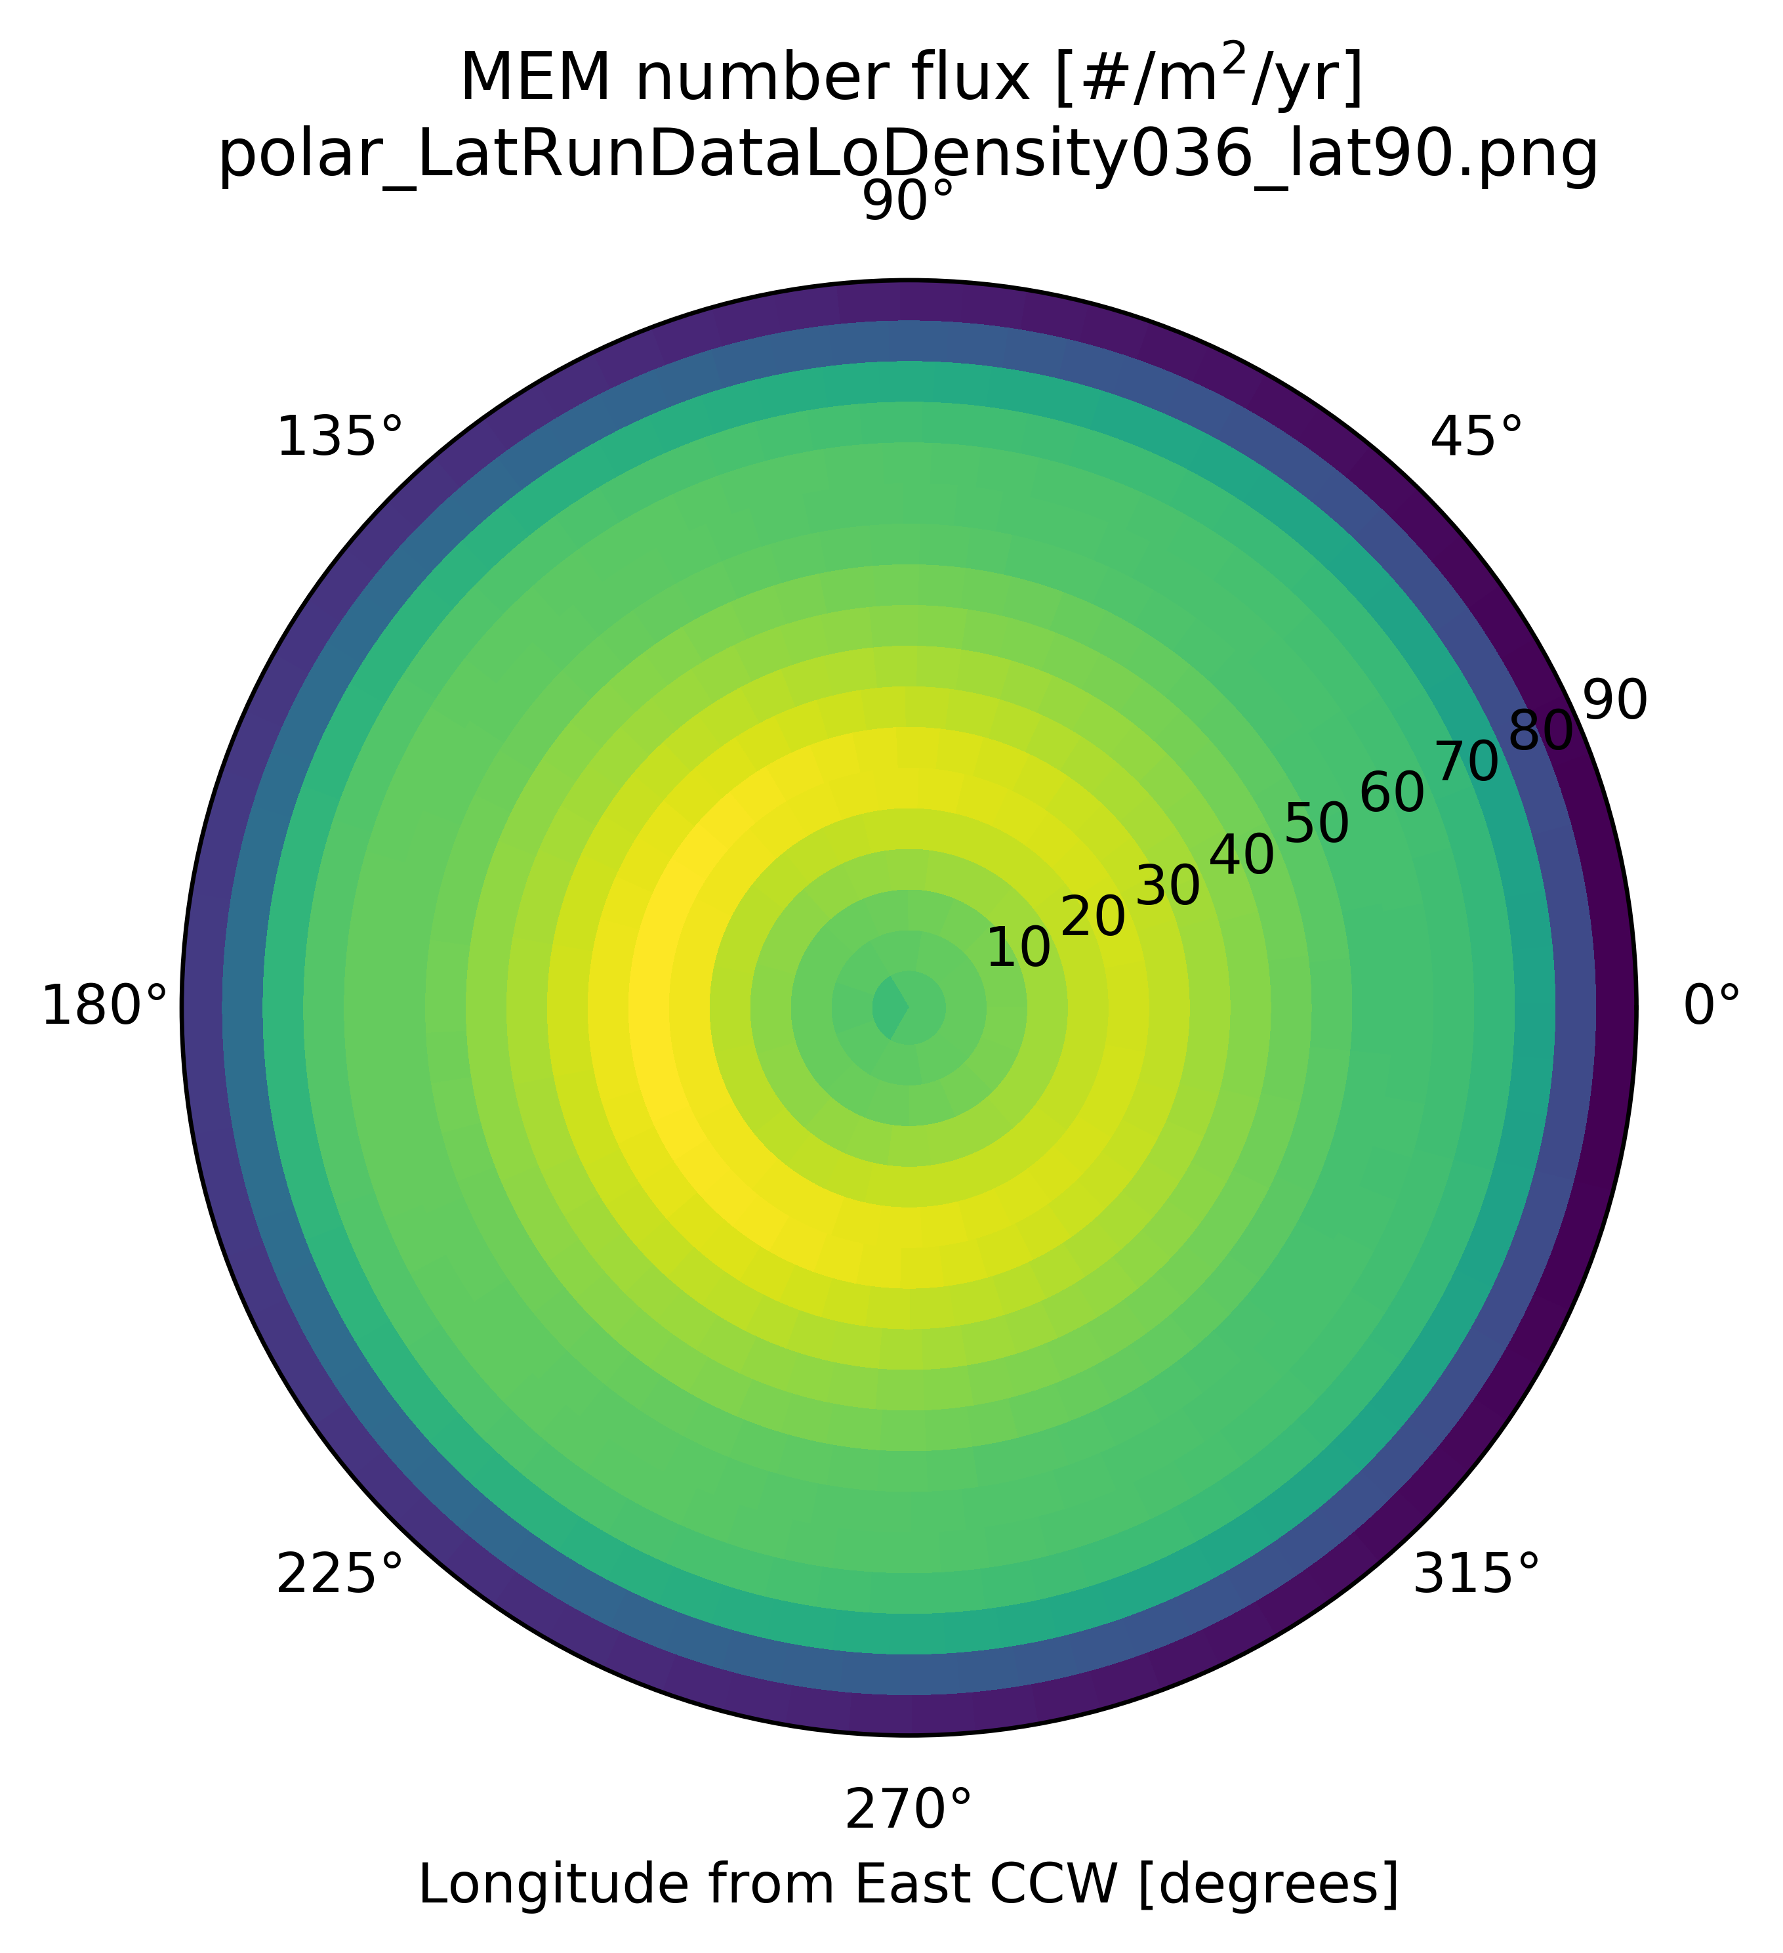
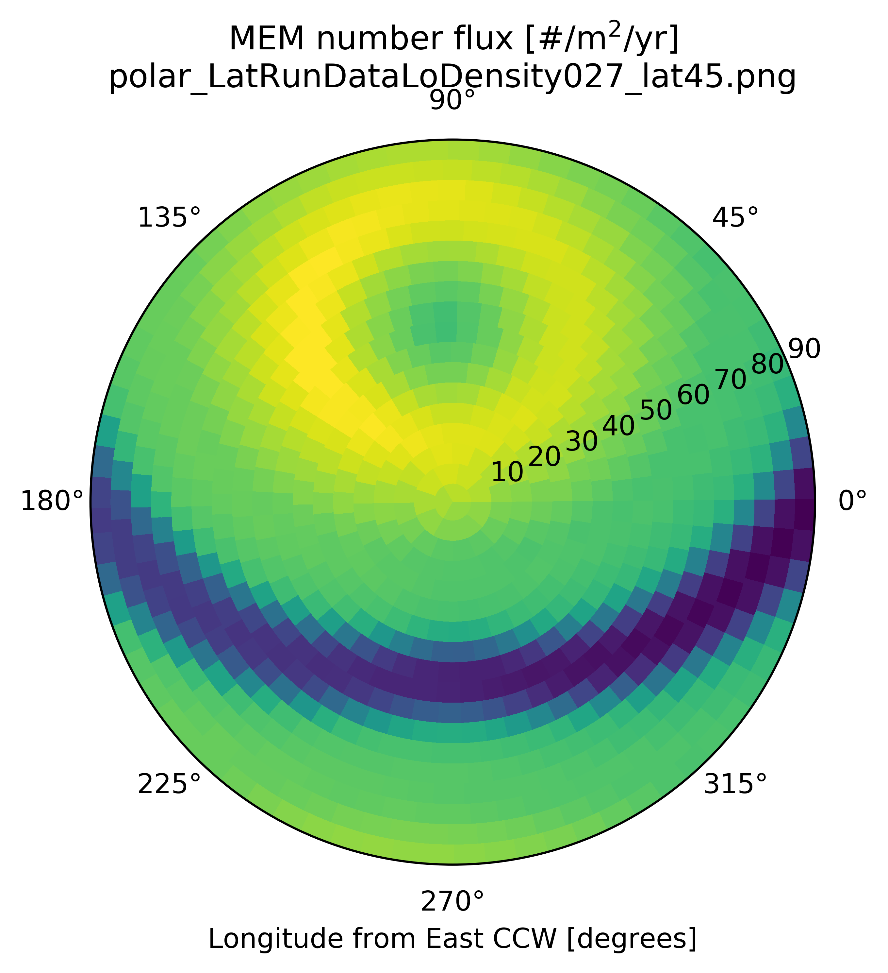
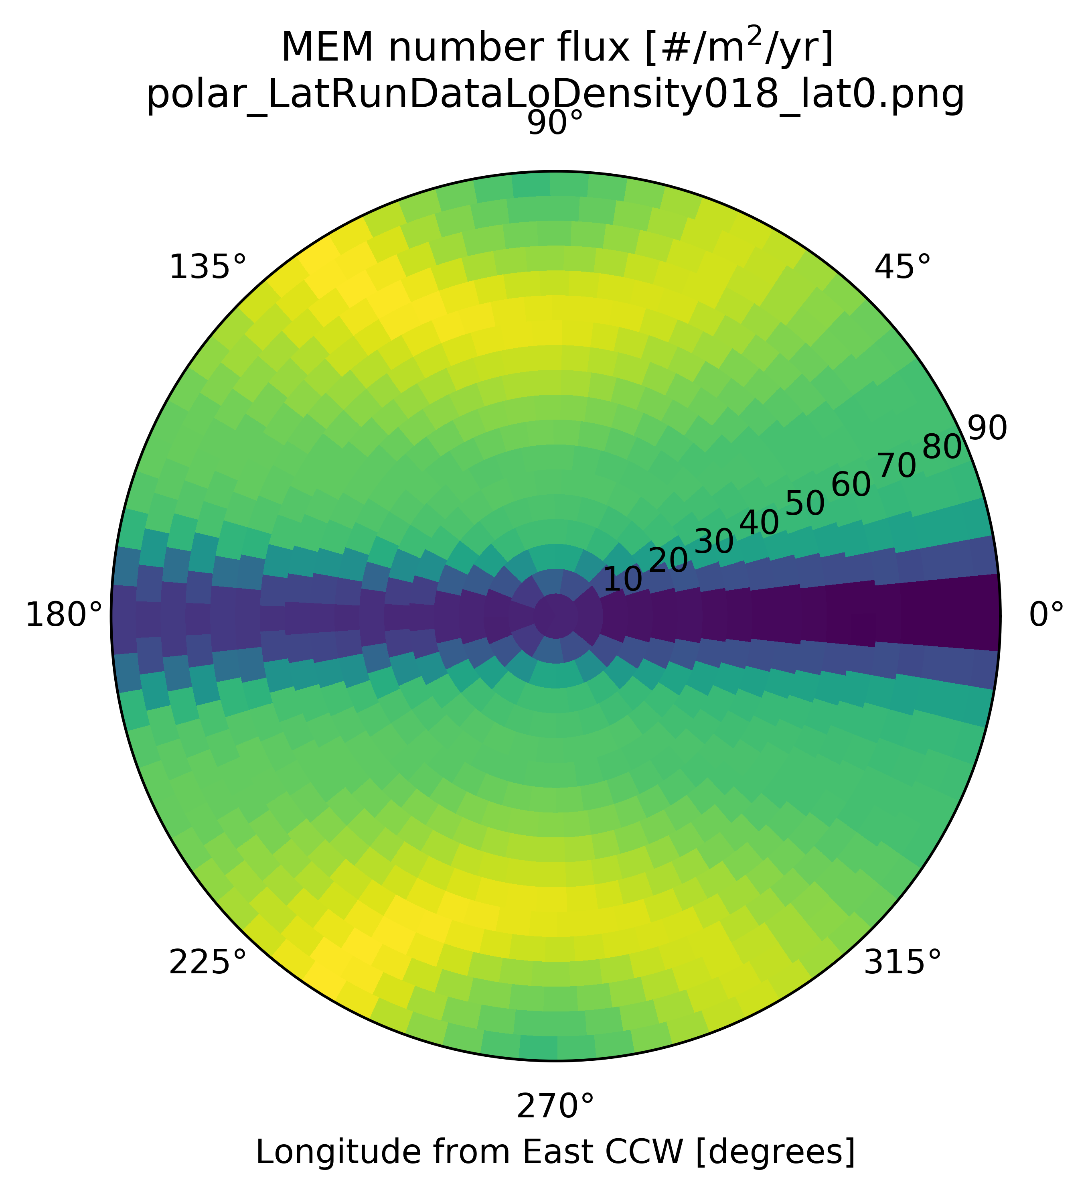
Sporadic meteoroid flux (alt/az) and latitudinal dependence on the lunar surface

Slide 10
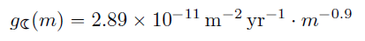
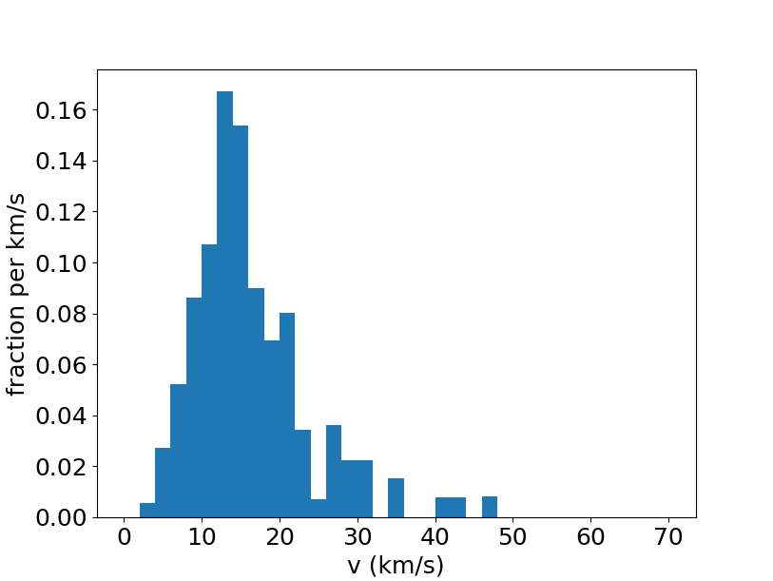
Near Earth Object (NEO) flux (Brown et al. 2002) at the lunar surface
Moorhead (see memo OSMA/MEO/Lunar-001) computed the NEO flux at the lunar surface based on Brown et al. 2002 and velocity distribution of bolides reported by the Center for Near Earth Object Studies (CNEOS)
In MELSEM, we approximate the angular distribution of fluxes at the lunar surface by the low-density population of MEM

Slide 11
Asset Geometry and Location
The asset, or observer, is the physical object at which the meteoroid ejecta is collected from all impacts over the entire surface of the Moon to generate the meteoroid ejecta environment
Typical simplifying shapes of the object include:
Sphere
Cylinder
Rectangular Prism
The asset can be made of any number of these shapes, but for simplicity, a cylinder is often chosen for a lunar lander
The location of the asset can be on the lunar surface or any distance above the lunar surface
In general, a full trajectory could be used, but a single-point location is used for simplicity

Slide 12


Impact-ejecta scaling model (Housen & Holsapple 2011)
$$\frac{M}{m}=\frac{3k}{4π}\frac{ρ}{δ}\left[{\left(\frac{x}{a}\right)}^{3}−n_{1}^{3}\right]$$
$$\frac{v}{U}=C_{1}{\left[\frac{x}{a}{\left(\frac{ρ}{δ}\right)}^{ν}\right]}^{−\frac{1}{μ}}{\left(1−\frac{x}{n_{2}R}\right)}^{p}$$
Where $n_{1}a≤x≤n_{2}R$
$x \text{acts} \text{parametrically} \text{for} \text{the} \text{ejecta} \text{mass} M \text{greater} \text{than} v \text{function}\text{, }\text{and} \text{the} \text{ejecta} \text{speed} v \text{function}$
$R \text{is} \text{the} \text{crater} \text{radius}\text{, }\text{dependent} \text{on} \text{the} \text{impact} \text{and} \text{target} \text{parameters}$
$a \text{is} \text{the} \text{impactor} \text{radius}$

Slide 13
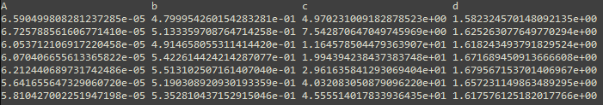
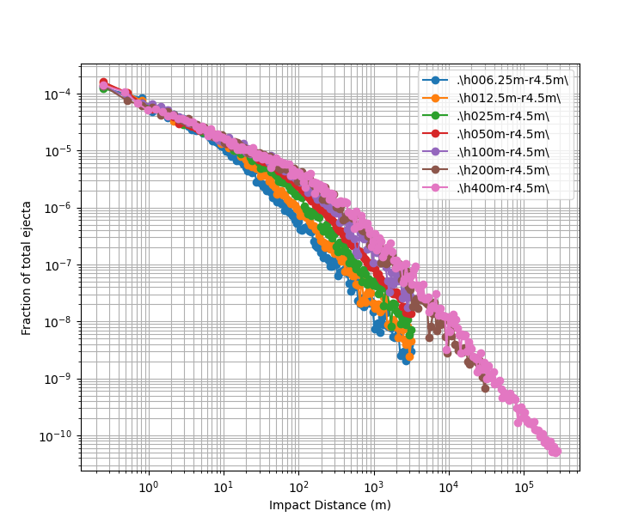
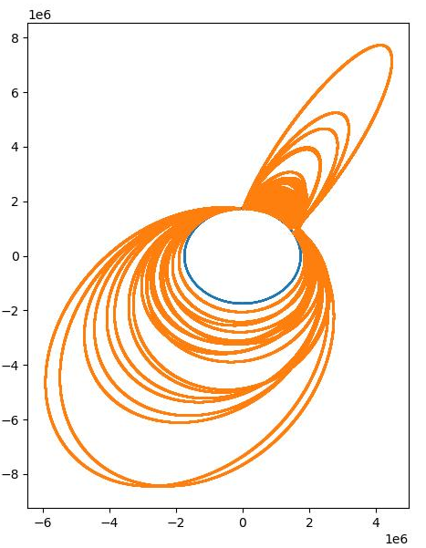
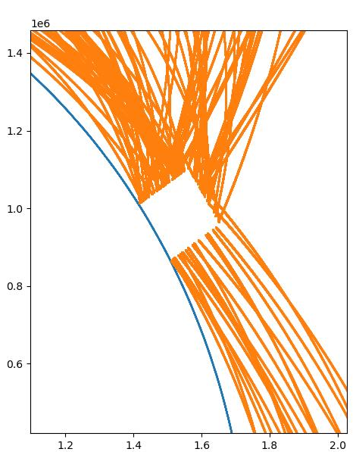


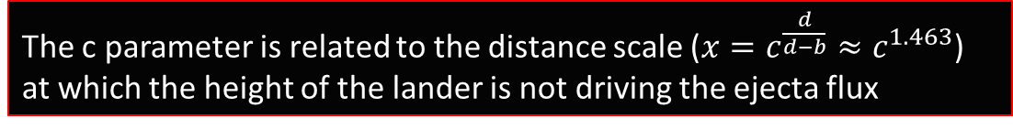

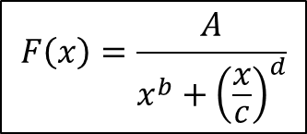
Differential ejecta flux vs. distance
*Assuming isotropic ejecta with a speed distribution $f\left(v\right)∼v^{−α}, α=2.2$
$$F\left(x\right)=\frac{A}{x^{b}+{\left(\frac{x}{c}\right)}^{d}}$$
Various cylindrical lander heights were simulated using Monte Carlo for various impact distances
For simplicity, these simulations used 2D due to the symmetry – off radial hits assumed to have same width as radial width (conservative)
Orbits solved using RKF45 integration of equations of motion (variable time stepping):
$\dot{r}=v$
$\dot{v}=a$
$a=\frac{F}{m}=−\frac{g}{r^{2}} \hat{r}$
MC sims show:
$b∼0.52$ and $d∼1.64$, very close to the analytic estimates!
The c parameter is related to the distance scale ($x=c^{\frac{d}{d−b}}≈c^{1.463}$) at which the height of the lander is not driving the ejecta flux
$$c=1.916∗{height}^{0.5633}$$

Slide 14
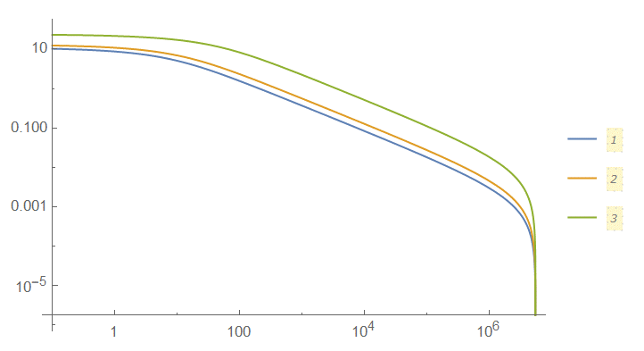

Integral ejecta flux vs. Impact distance
$I_{ejecta flux}\left(d_{I}\right)=\int_{d_{I}}^{πR_{m}}{dx F(x)}$, the integral ejecta flux as a function of impact distance $d_{I}$
$F\left(x\right)=\frac{A}{x^{b}+{\left(\frac{x}{c}\right)}^{d}}$ , the differential ejecta flux as a function of distance $x$
From analytic results, we expect:
$b=\frac{α−1}{2}=0.6$ (0.52 from MC), and
$d=\frac{α+1}{2}=1.6$ (1.64 from MC)
Due to the speed distribution $f\left(v\right)∼v^{−α}, α=2.2$
1: h=7m
2: h=11m
3: h=50m
Integral ejecta flux (fraction of ejecta flux > d_I)
Impact Distance (from lander edge) (m)

Slide 15
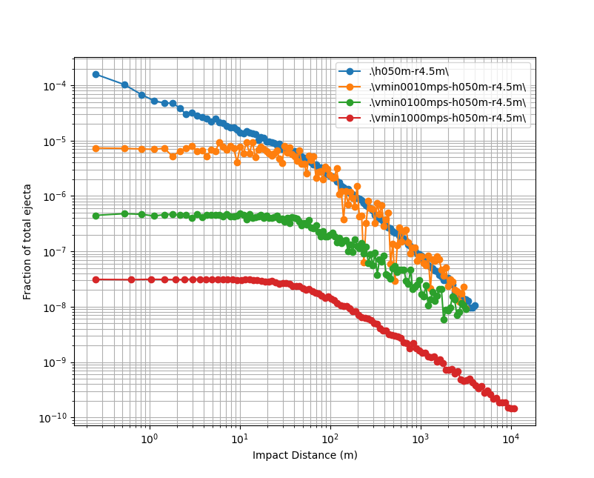
Effects of minimum ejecta speed on differential ejecta flux
Imposing a minimum ejecta speed eliminates the bulk of the ejecta at close distances
Low-energy ejecta (speed and mass) may be irrelevant to the impact risk
Further distances are not affected by a minimum speed cut-off
Not enough speed to reach far distances in the first place

Slide 16
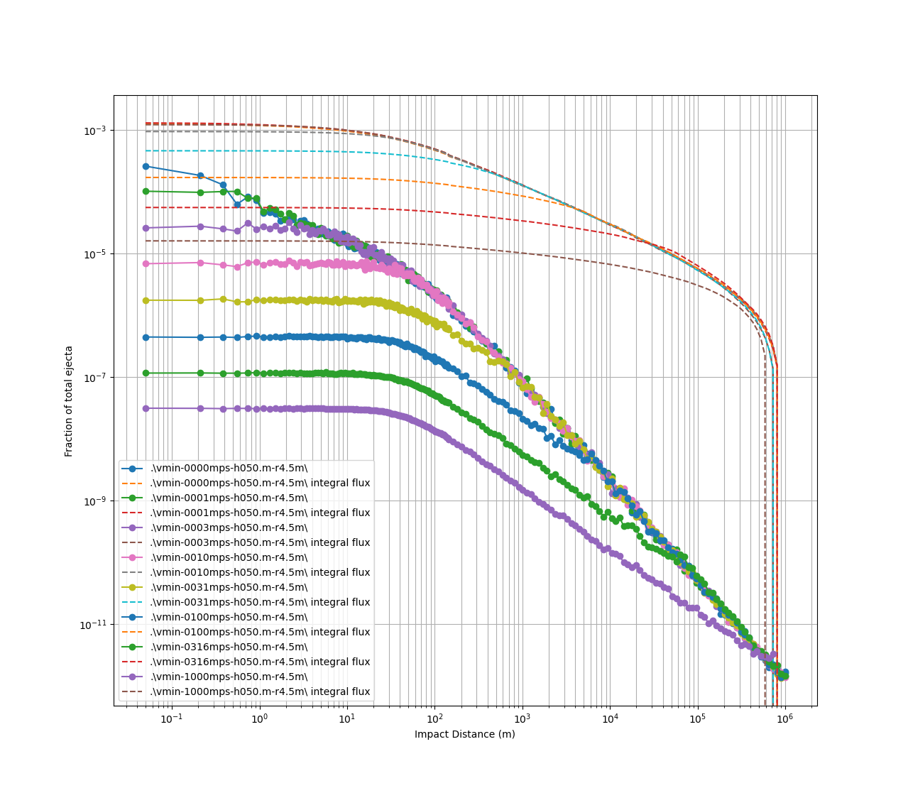
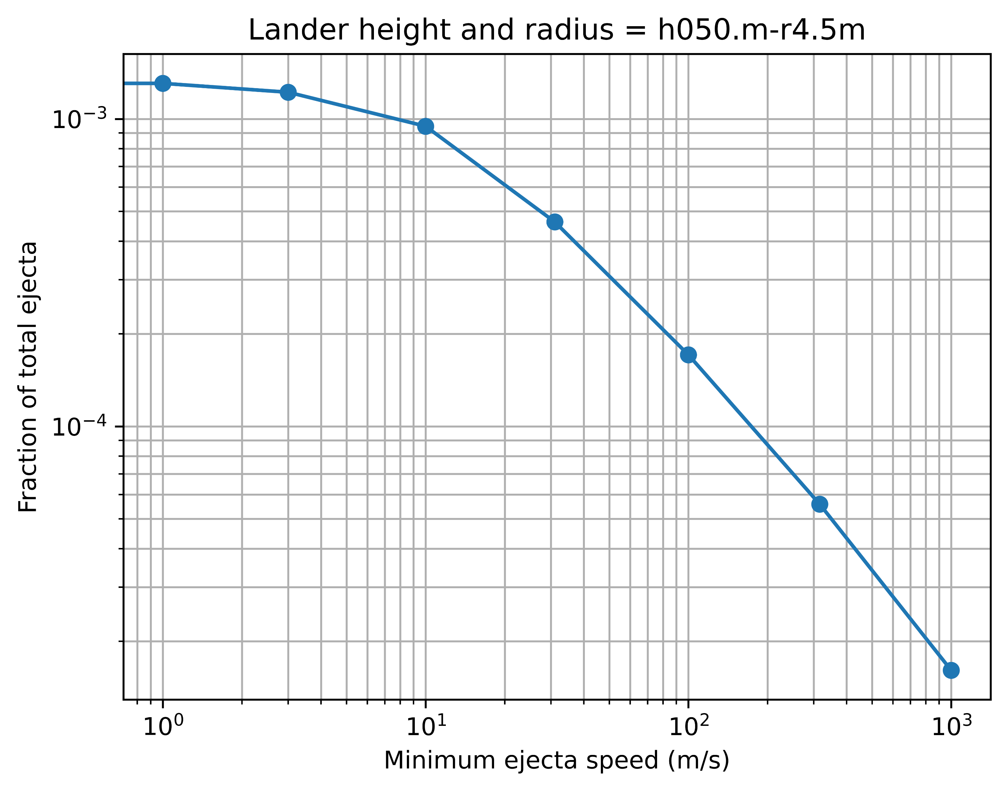
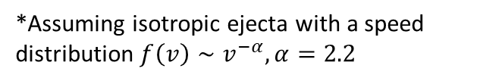
Differential flux (solid-marked) and integral flux (dashed) vs. min speed cut-off
Integral flux is flux of ejecta from distances d and further, for all speeds greater than vmin
E.g., 86.5% of the ejecta hitting the lander is < 100 m/s
*Assuming isotropic ejecta with a speed distribution $f\left(v\right)∼v^{−α}, α=2.2$

Slide 17
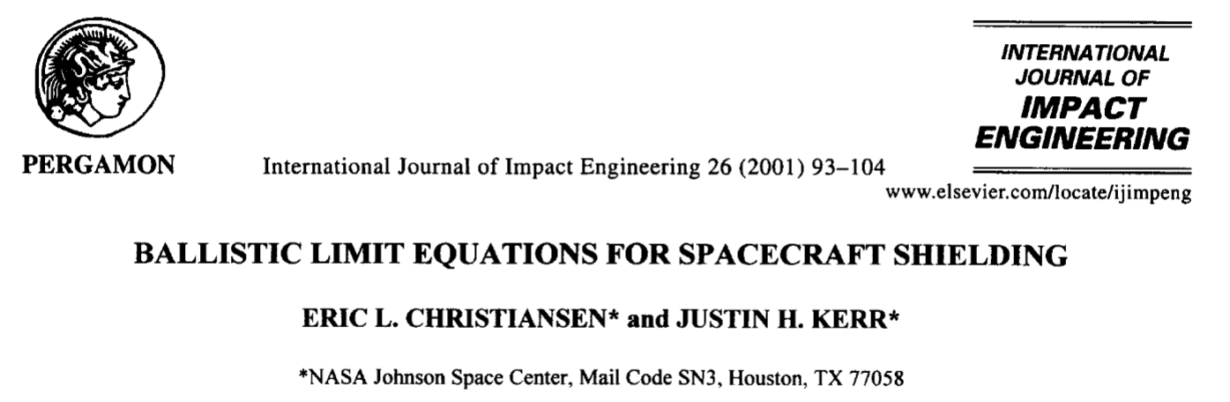
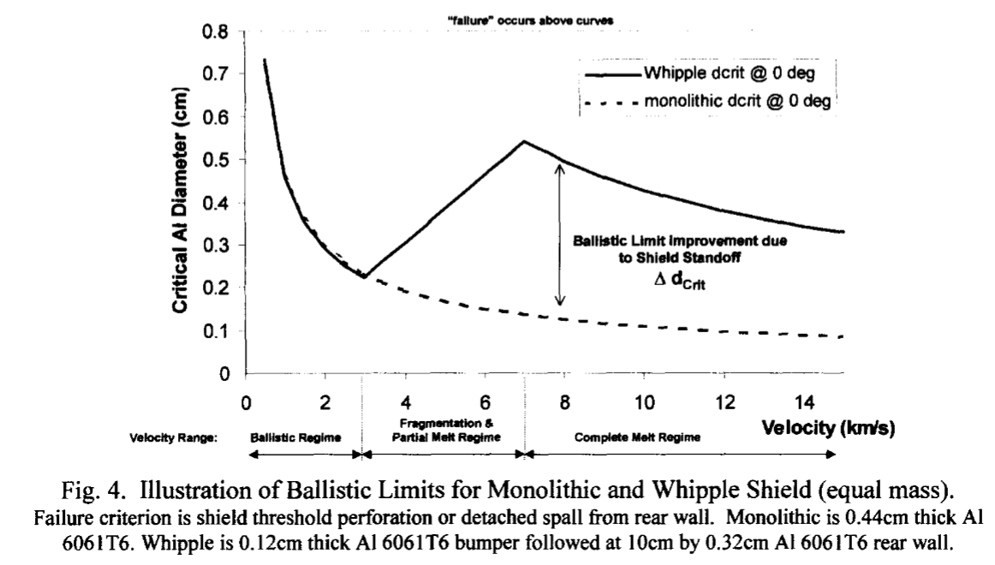
Probability of No Penetration – Ballistic Limit Equations
Example of a ballistic limit equation (BLE):
For a given particle speed, failure/PNP is defined as the particle diameter above the curve
Different shielding designs will achieve different BLEs
Lunar escape speed is 2.38 km/s
Typical M/OD shielding designs might not be as effective for slower meteoroid ejecta
If an impact occurs very close to the asset (lunar lander), a small fraction of the ejecta will have speeds greater than lunar escape speed

